Slide 1
The Impacts of Education
Unit 3.3

Slide 2
Your “Best Path”
Which would be the best path for you after high school?
College
Military
Career
Travel
Why?
Notes:
Remind students about the discussions from the Postsecondary Options lesson in which they identified the option category that was the best fit for them. Ask how many students have the college category as their identified best path. Discuss why college plays such an important role in their future plans.

Slide 3
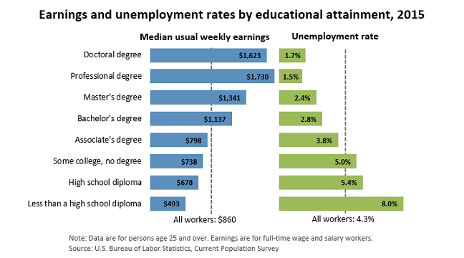
Earnings by Education
Notes:
Discuss the above graphic that illustrates the weekly earnings and unemployment rates that accompany various education levels.

Slide 4
Finances of the College Decision
Is going to college financially worth it?
Career After High School
Education debt: None
Median annual salary over career: $35,724
Immediate earnings
College After High School
Education debt: $35,000
Median annual salary over career: $59,124
Delayed earnings: 4 years
*Bachelor’s Degree

Slide 5
Finances of The College Decision
Notes:
Discuss with students the above graphic which illustrates the lifetime earnings of two median annual incomes based on education level. Point out that this graph assumes median earnings throughout a career. Ask students the following questions:
How long before the college degree becomes financially “worth it”?
What is the approximate difference in total lifetime earnings?

Slide 6
The ROI of College Degrees
ROI: Return ON investment (how much you benefit).
Expressed as a percentage ratio.
Sometimes “return OF investment”
We refer to ROI as “ON” not “OF” in this class
How low it will take to recoup initial investment
Notes:
Explain that to calculate ROI, divide the investment’s benefit (return) by the cost of the investment and expressed as a percentage ratio:

Slide 7
The ROI of College Degrees
ROI Example Problem: Your degree costs $50,000 and allows you to get a job that pays $60,000 a year.
Step 1: Calculate the benefit.

Slide 8
The ROI of College Degrees
Step 2: Calculate the ROI.
In one year you will get a return of all of your investment plus an ROI of 20%.

Slide 9
The ROI of College Degrees
Go to my course website. On the “Links” page, click on:
“ROI of College Degrees”
Determine the ROI for the first two occupations listed:
Advertising, marketing, etc.
Economist
Notes:
Have students go to the site at the following link (post this link to your own class website so students do not have trouble typing it in):
http://www.bankrate.com/finance/college-finance/roi-college-degree.aspx
This site lists a number of occupations along with relative information regarding necessary education, cost of degree, and annual net salaries.
Have students determine the ROI for the first two occupations listed: Advertising, etc. and Economist. Their ROIs are 42 percent and 19 percent, respectively.

Slide 10
The ROI of College Degrees
Just by looking at the cost of the degree and the expected net salary, what can you say about the ROI of a veterinarian?
Notes:
Discuss with students how comparing just the annual salary and the degree cost there is a negative benefit.
In order to get an ROI, you must consider more than one year.
This is an example when the return OF investment should be taken into consideration when making career decisions.

Slide 11
My Career ROI
Research online to find the cost of the degree you are most interested in as well as the annual salary of the career you want to have.
Multiply the gross salary by 0.75 to get the net pay (benefit)
Calculate the ROI of your college/career then write it on the board with the name of the career and degree.
Notes:
Have students do some research online to find the cost of the degree they are most interested in as well as the annual salary (if net is not available, they should multiply gross by 0.75) of the career they want to have. Once they have completed this, have them calculate their respective ROIs and then write them along with the career on the board for comparisons. Pick one or two and create a line graph illustrating the cost-over-time relationship.

